Slide 1
MCTE 3104 Mechatronics Interfacing Lab
Session no. 10 : Introduction to IOT (Part II)

Slide 2
Outline
HTTP (Hypertext Transfer Protocol) (review)
Http and how the web works
HTTP Methods
REST API
ESP-8266
Getting started with ESP-01 module
Do http request
Connect to Firebase Real-time database

Slide 3
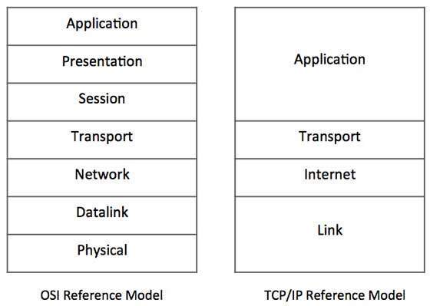
HTTP protocol
HyperText Transfer Protocol
One of the most widely used internet protocol in the world.
HTTP is an application layer protocol that allows web-based applications to communicate and exchange data
Think the HTTP as the messenger of the web
It is a TCP/IP based protocol
It is used to deliver contents, for example, images, videos, audios, documents, etc.
The computers that communicate via the HTTP must speak the http protocol
HTTP exist here!

Slide 4
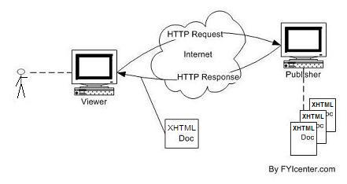
The Request-Response Cycle
server
client
file
file
file
file
Say a user wants to see a website and types in a url of the page usually on a browser.
The user needs to be physically connected to the internet; this is where the TCP/IP protocol makes communication on physical connection between machines possible.
When the connection is established, the client sends a request called HTTP message and then disconnects from the server waiting for a response.
The server on the other hand prepares the response, establishes the connection again and send back the response called HTTP message to the client and then disconnects.

Slide 5
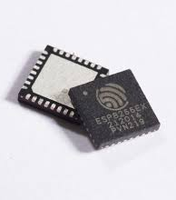
ESP8266

Slide 6
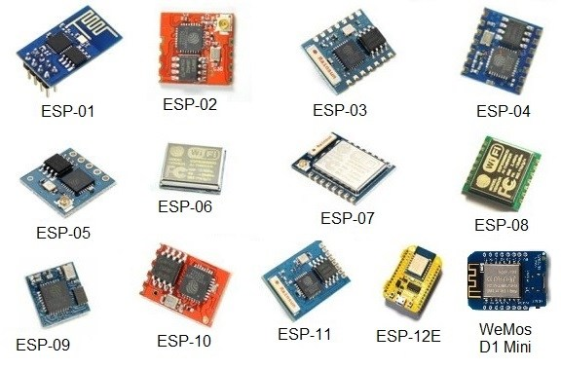
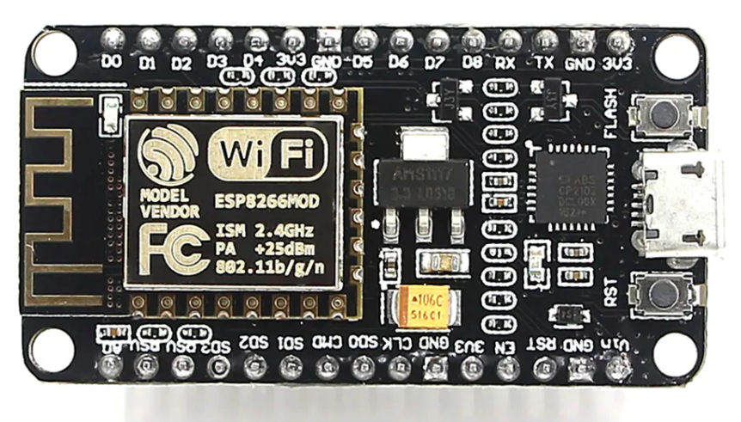
ESP8266
Low cost microcontroller with full TCP/IP stack Wi-Fi capability produced by shanghai-based manufacturer Espressif Systems.
To use the ESP8266 a lot of modules are made for us to use
NodeMCU

Slide 7
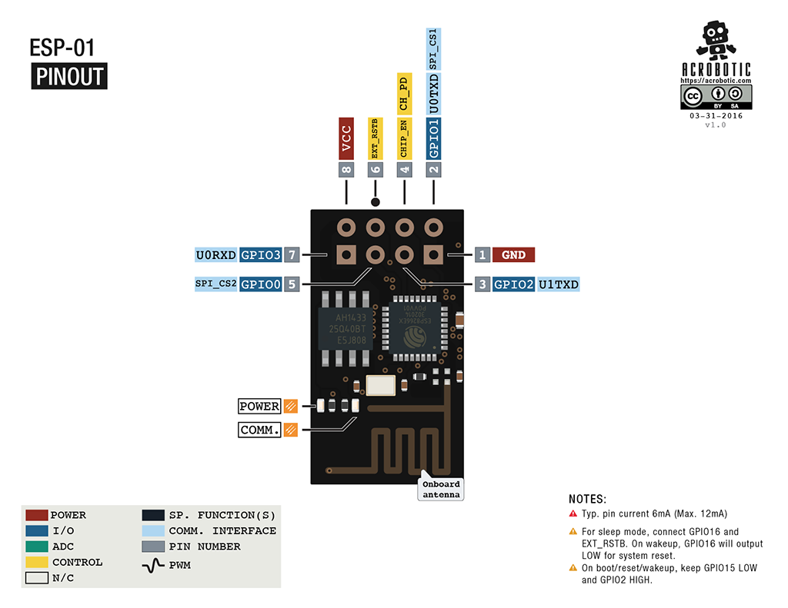
Esp8266 specifications
. 11 b/g/n protocol
. Wi-Fi Direct (P2P), soft-AP
. Integrated TCP/IP protocol stack
. Built-in low-power 32-bit CPU
. SDIO 2.0, SPI, UART

Slide 8
ESP8266
So what are the few things we can do with this module?
. Create a web server
. Send HTTP requests
. Control outputs
. Read inputs and interrupts
. Send emails
. Post tweets
and many more…

Slide 9
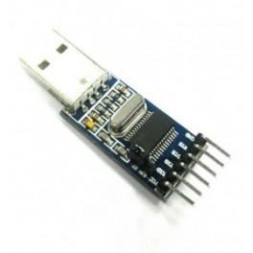
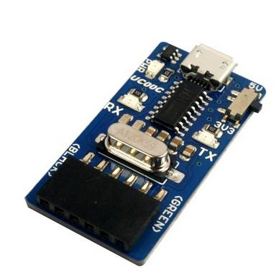
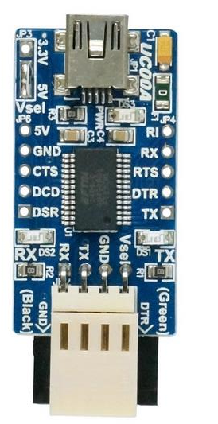
ESP8266
ESP8266 is Arduino code compatible which means you can write and code with using the Arduino IDE.
The ESP01 however does not have a USB-UART converter to communicate with the PC. So we have to use a separate USB-UART converter to flash codes in the ESP01.
Here are some cheap USB-UART converter you can buy online:
FTDI - FT232RL
Prolific - PL2303
CH340G

Slide 10
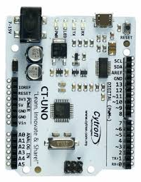
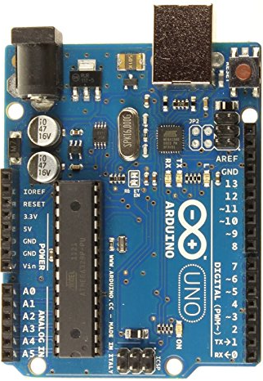
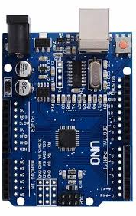
USB – UART Converter
FTDI - FT232RL
ATMEGA16U2
CH340G

Slide 11
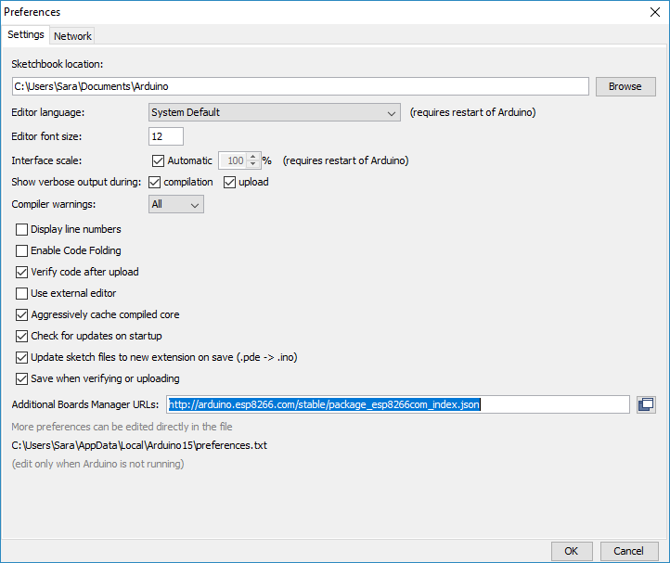
ESP8266
Getting Started with ESP-01
1. We first need to install the ESP8266 Board in the Arduino IDE
. Open the preferences window from the Arduino IDE. Go to File > Preferences
. Enter http://arduino.esp8266.com/stable/package_esp8266com_index.json into the “Additional Board Manager URLs” field as shown in the figure below. Then, click the “OK” button.

Slide 12
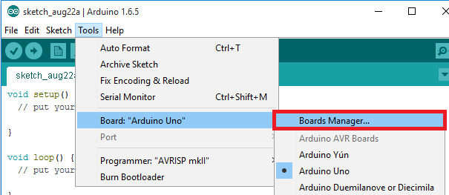
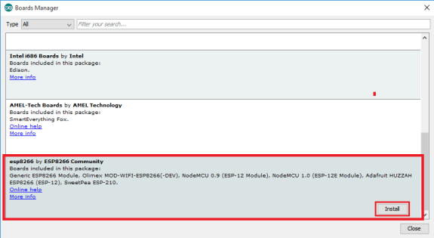
ESP8266
2. Install the ESP8266 boards
Search for Esp8266
Click install

Slide 13
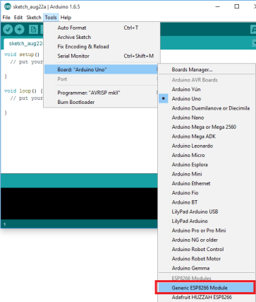
ESP8266
3. Select board as ‘Generic ESP8266 Module’
Now you can start uploading code to the ESP01

Slide 14
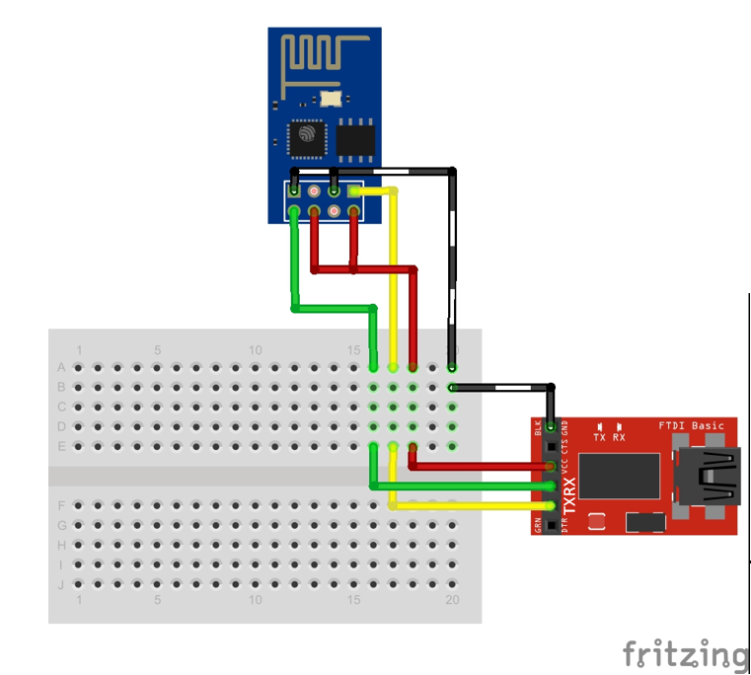
ESP8266
Connection:
ESP01 UART-USB
GND GND
VCC (3.3V) VCC (3.3V)
TX RX
RX TX
CH_PD VCC (3.3V)
GPIO0 GND
Prepare the ESP01 for flashing codes (using UART-USB converter)
Note: if you’re using the Arduino board as a UART-USB converter, connect the TX of ESP01 to TX of Arduino board and connect the RX of ESP01 to RX of Arduino board.

Slide 15
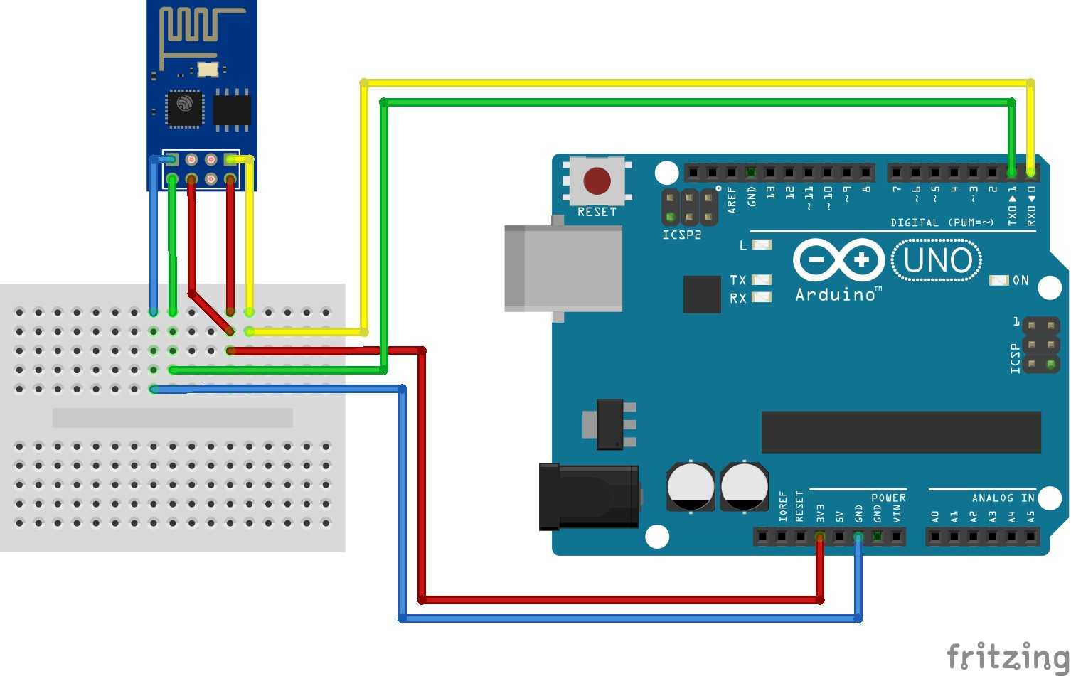
ESP8266
Connection:
ESP01 UART-USB
GND GND
VCC (3.3V) VCC (3.3V)
TX TX0 (of Arduino)
RX RX0 (of Arduino)
CH_PD VCC (3.3V)
GPIO0 GND
Prepare the ESP01 for flashing codes (using Arduino board as UART-USB converter)
Note: if you’re using the Arduino board as a UART-USB converter, connect the TX of ESP01 to TX of Arduino board and connect the RX of ESP01 to RX of Arduino board.
Note: by grounding the reset pin you disabled the main microcontroller (i.e. Atmega328 or Atmega2560). The Arduino board functions as a UART-USB converter.

Slide 16
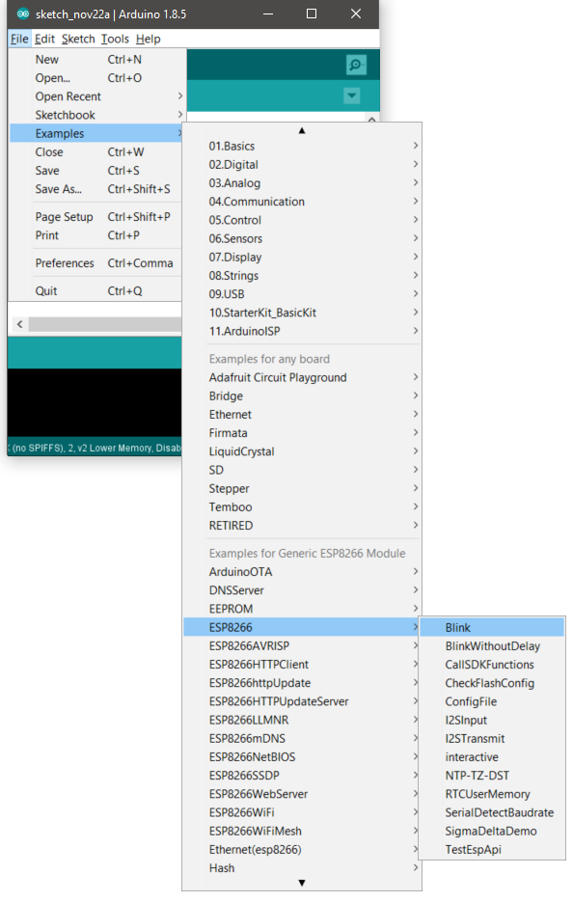
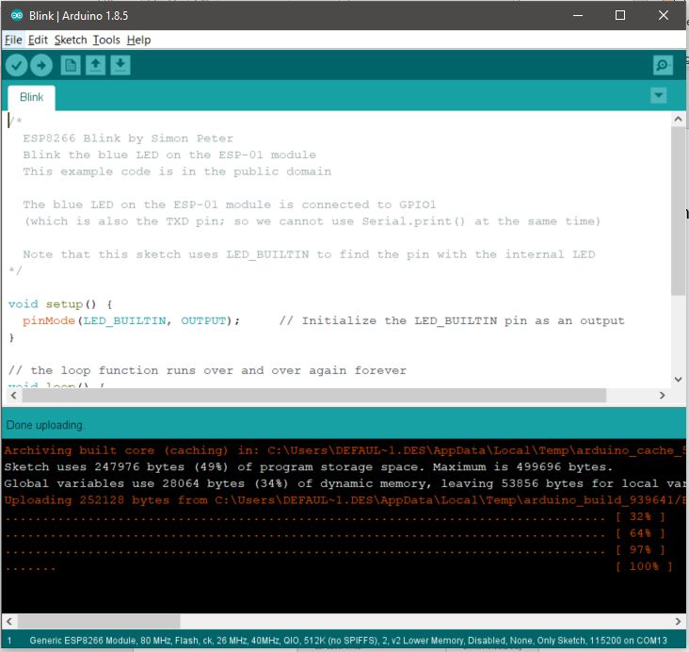
ESP8266
Now upload a test code to the ESP-01 to see if all connections are correct
Try uploading the example blink code, or any empty code.
If this orange message appears, it means you’ve successfully uploaded your code to the ESP-01
Note: for some reason, you need to unplug and plug back the ESP-01 from your PC every time you need to flash a new code.

Slide 17
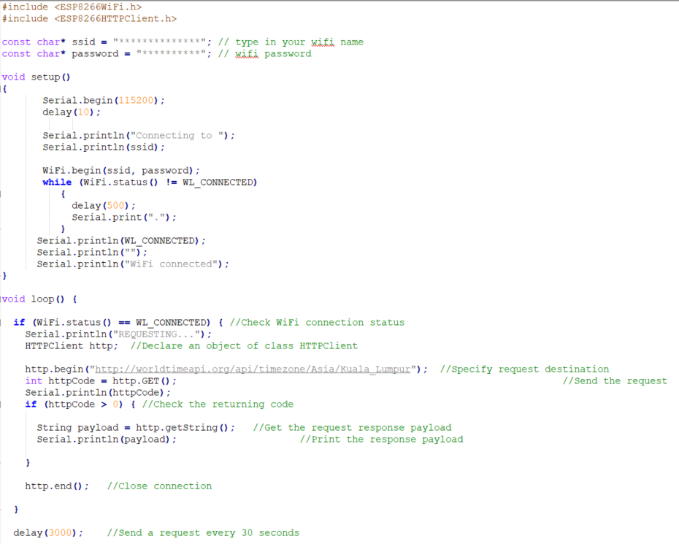
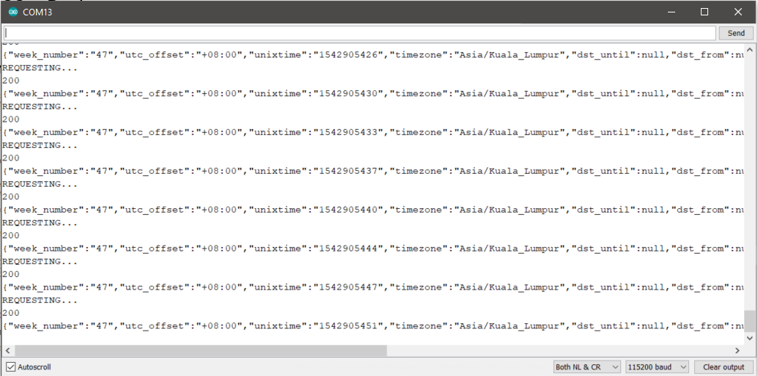
ESP8266 – Do http request
The ESP8266HTTPClient library allows you to do http request to REST api.
Example 1: Making simple GET requests on the ESP8266
Output from the ESP8266

Slide 18
Http request a REST Api on the ESP8266
Lab activity 1:
Find a free online REST API service and make GET requests using the ESP-01.

Slide 19
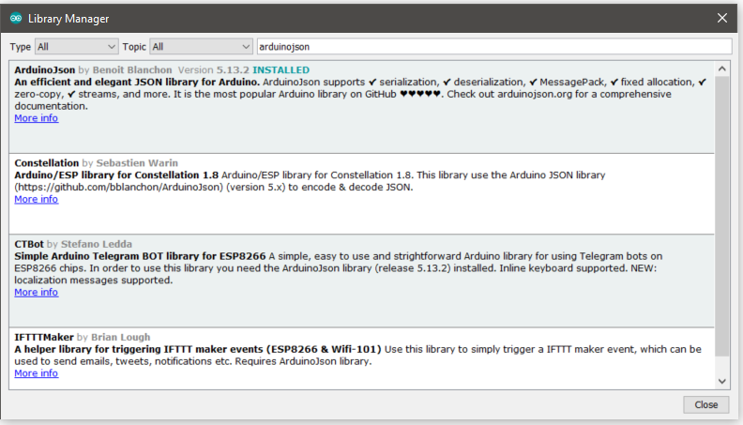
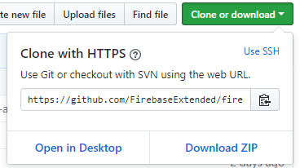
ESP8266 Connecting to Firebase
. To connect to firebase, we can’t just use simple http request because Firebase requires a secure https request to be made.
. FirebaseArduino now depends on ArduinoJson library instead of containing it's own version of it. Please either use Library Manager. We recommend that ArduinoJson is at least version 5.13.2
. Go to https://github.com/FirebaseExtended/firebase-arduino and click ‘Download ZIP’
. Extract the file and put the folder in ‘…/Documents/Arduino/Libraries’ of your PC

Slide 20
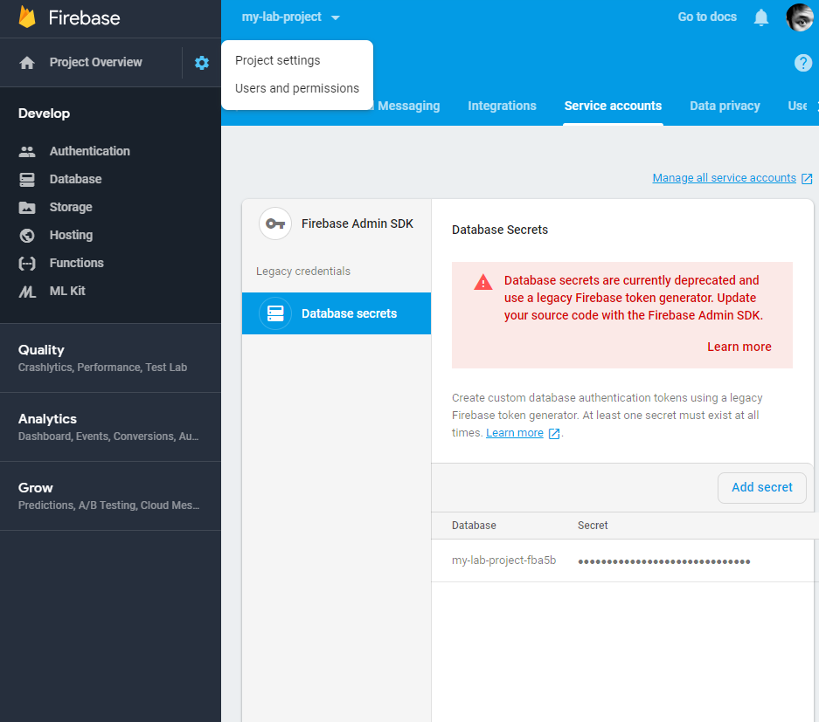
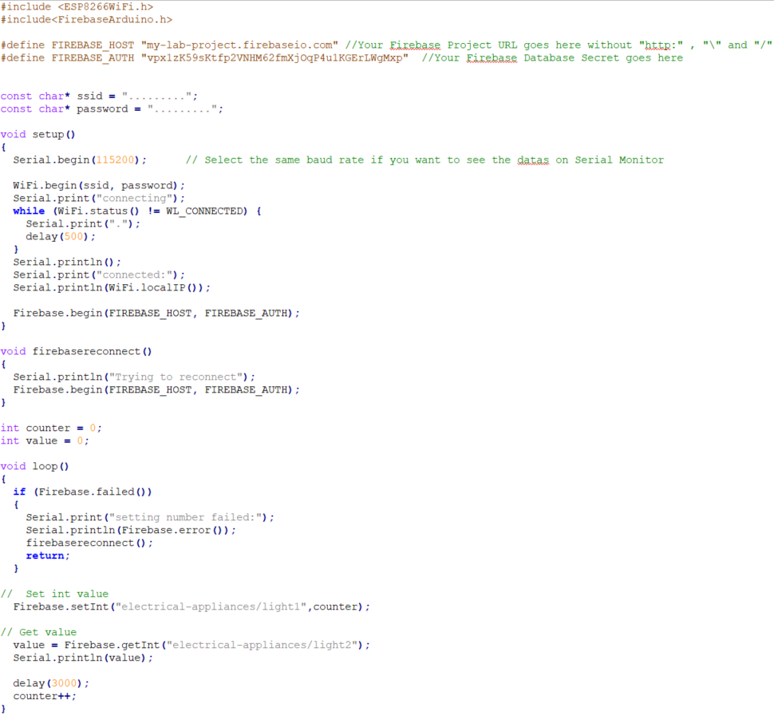
ESP8266 Connecting to Firebase
Example 2: Connecting to Firebase database using ESP8266

Slide 21

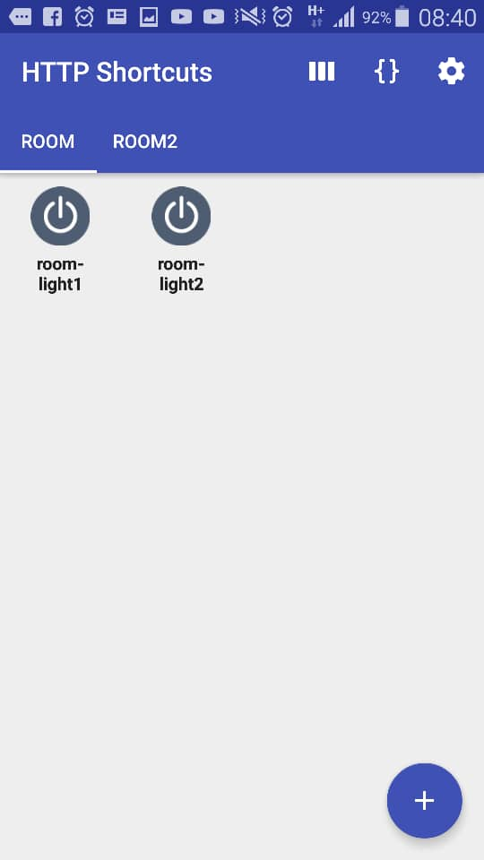
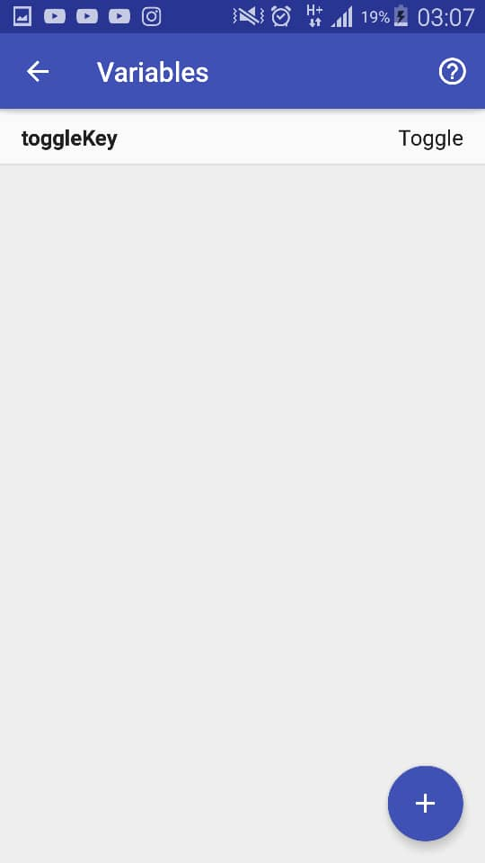
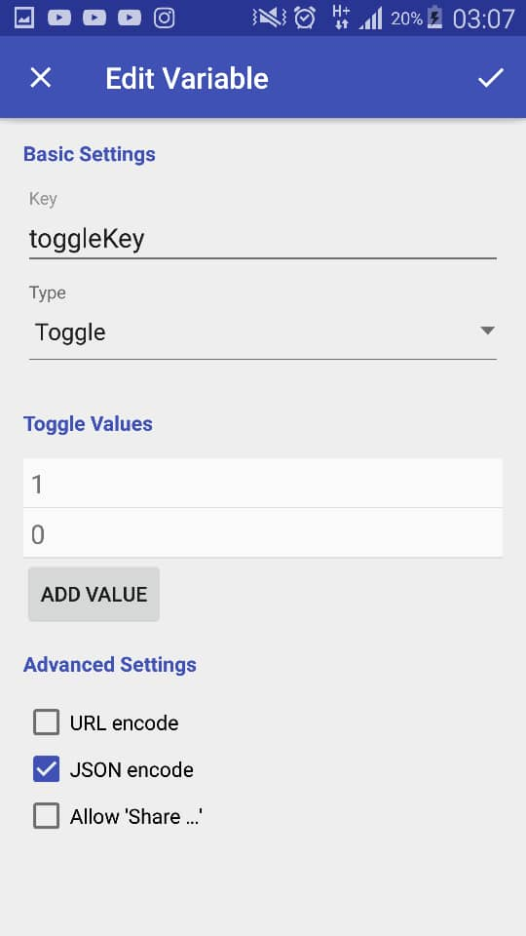
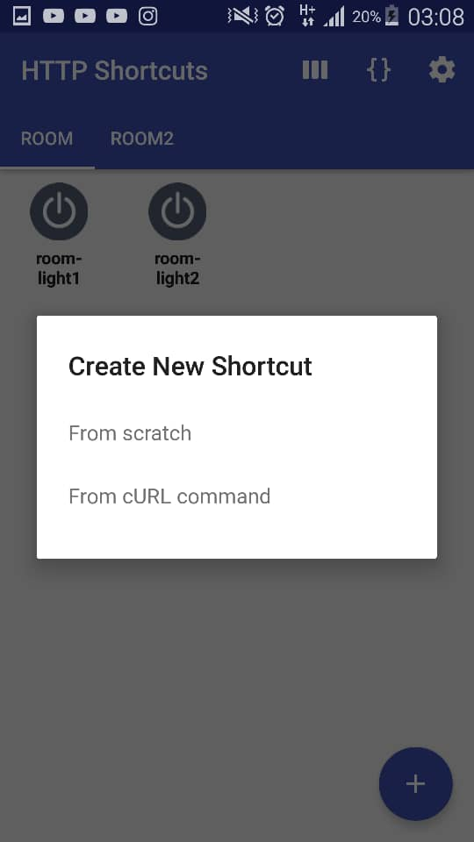
ESP8266 Connecting to Firebase
Example 3: Connecting to Firebase database using HTTP Shortcuts
Download HTTP Shortcuts app on your Android
https://play.google.com/store/apps/details?id=ch.rmy.android.http_shortcuts&hl=en
. Add cURL command by following the same format below
Home page
Create variable
curl https://my-iot-room.firebaseio.com/electrical-appliances/lights.json -X PUT -m 10000 -d {{toggleKey}}

Slide 22
ESP8266 Connecting to Firebase
Example 3: Connecting to Firebase database using HTTP Shortcuts
Since our variable is a toggle switch, every time you press it will either toggle to value ‘1’ or value ‘0’. Feel free to explore other variables.

Slide 23
ESP8266 Connecting to Firebase
Lab activity 2:
Using the ESP-01, control an led using the ‘HTTP shortcuts’ app. (make use of firebase)

